Slide 1
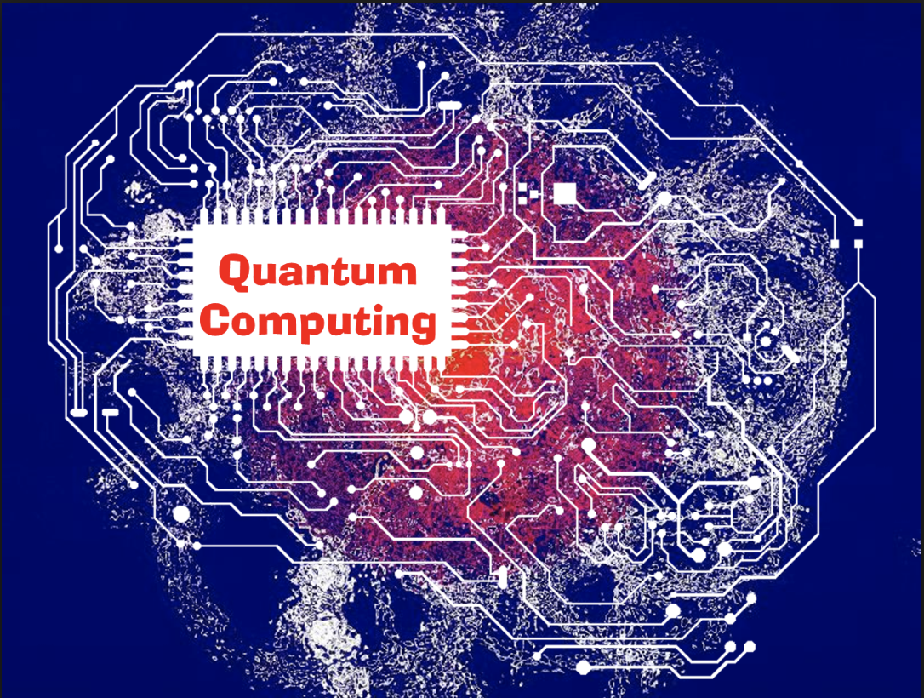
Quantum Deep Learning
Undergraduate Study
Hanjin Choi, Myungwoo Song. Korea University, School of Electrical Engineering
zxa018@korea.ac.kr
erados@korea.ac.kr

Slide 2
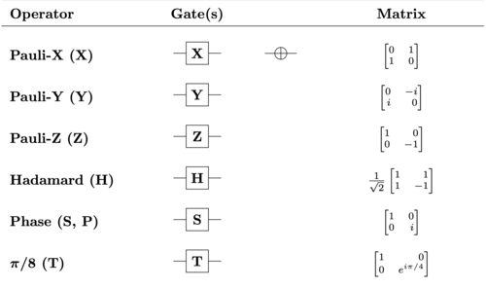
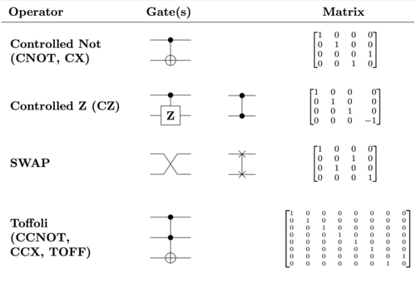
Fundamental gates

Slide 3
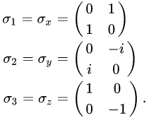
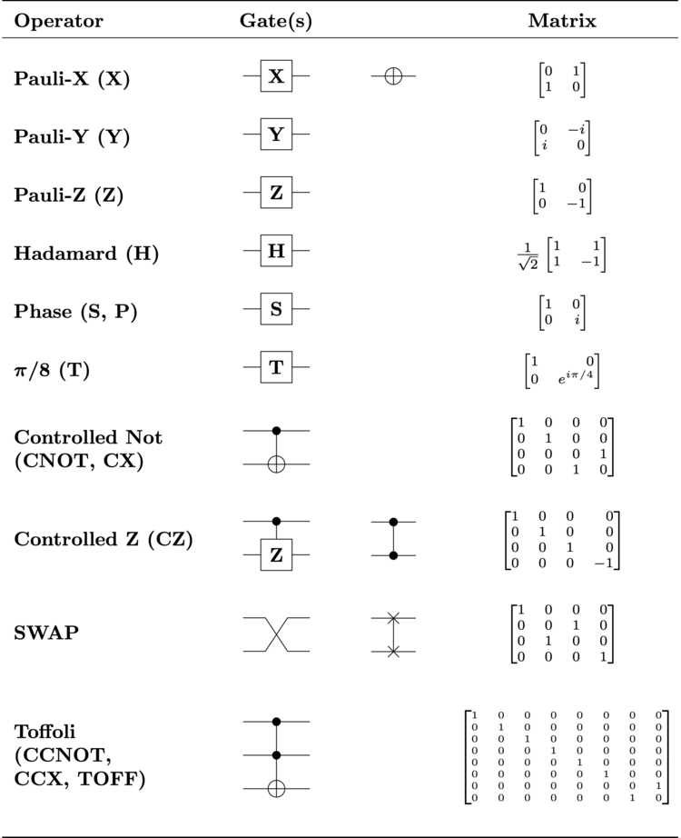
Pauli gates
Pauli-X gate: quantum equivalent of the NOT gate for classical computers.
Pauli-Y gate: rotation around the Y-axis of the Bloch sphere by 𝛑 radians.
Pauli-Z gate: rotation around the Z-axis of the Bloch sphere by 𝛑 radians.

Slide 4
Pauli gates
X gate | Y gate | Z gate
|0〉 => |1〉 | |0〉 => i|1〉 | |0〉 => |0〉
|1〉 => |0〉 | |1〉 => -i|0〉 | |1〉 => -|0〉

Slide 5


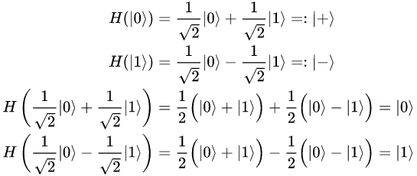
Hadamard gate
Hadamard gate: Used to create superposition of |0> and |1> state.

Slide 6




Phase (S, P) gate

Slide 7
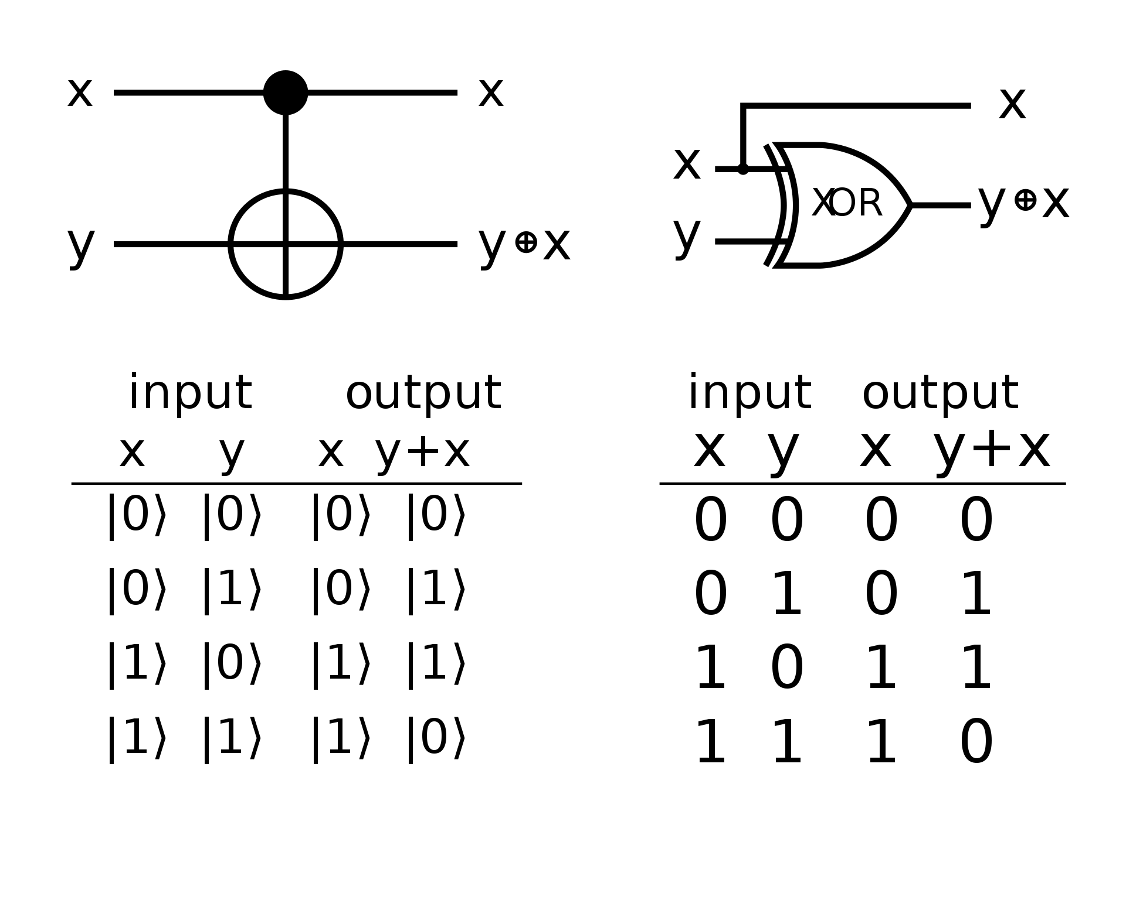
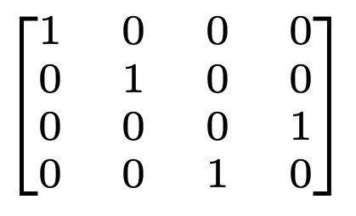
Controlled NOT gate
Matrix
Truth table
Quantum computer
Classic computer

